Slide 1
Sample : Project Kick-Off Meeting
Website Redesign Project for Beauty Product Selling Company

Slide 2
Why this Sample ?
Educational Purpose: This sample is designed to educate and guide you through the creation of effective Project Kick-Off meeting slides.
For PMP Participants: If you're preparing for your PMP certification, this template will help you relate to key concepts and best practices in project management.
Starting Template: Perfect for those looking for a starting point, this sample provides a structured approach to your Project Kick-Off meetings.
Adaptable to Organizational Templates: While this sample offers a general framework, it’s likely that you will customize it using your organization's specific template and requirements.

Slide 3
Project Kick- Off Meeting
Agenda
Objective
Creates a shared understanding of the project's goals, scope, development approach, roles, and timelines, ensuring alignment and clarity among all team members and stakeholders
Welcome & Introductions
Project Overview
Scope & High-Level Plan
Roles & Responsibilities
Communication Plan
Risk & Assumptions
Quality Management
Change Control
Action Plan
Q&A & Closing
Reminder
Respect everyone's time
Keep discussions focused on the meeting agenda
If something is unclear, ask for clarification.

Slide 4
Project Overview

Slide 5

Project Vision
To create a modern, responsive website that enhances user engagement, supports business goals, and provides a seamless, accessible digital experience for all visitors.

Slide 6

Project Objectives
Enhance User Experience: Improve usability, accessibility, and overall user satisfaction.
Modernize Visual Design: Contemporary design standards and align with the brand’s identity.
Increase Mobile Compatibility: Optimized for all mobile devices, providing a consistent experience across platforms.
Improve Content Management: Implement a new content management system (CMS) .
Boost SEO Performance: Increase organic traffic, improve search engine rankings, and enhance online visibility.

Slide 7

Key Stakeholders and Expectations
Stakeholder | Role | Expectation from the Project
Jane Smith | Project Sponsor | A modern, user-friendly website that enhances brand image and supports business goals.
Tom Roberts | Sales Director | A website that effectively showcases products/services, driving higher conversions and sales.
Laura Wilson | Client Representative | A seamless user experience and design that aligns with client’s vision and expectations.
Mark Taylor | Support Team Lead | A website that is easy to support, with minimal issues post-launch and efficient support handover.

Slide 8
Scope and High Level Plan

Slide 9

Project Scope
In-Scope:
  Redesigning the homepage and key internal pages
  Implementing a new CMS
  Conducting user experience (UX) testing
  Optimizing the website for SEO
  Ensuring mobile responsiveness
  Migrating existing content to the new site
Out-of-Scope:
  Redesigning third-party integrated systems
  Developing new content
  Extensive custom feature development beyond the CMS capabilities

Slide 10

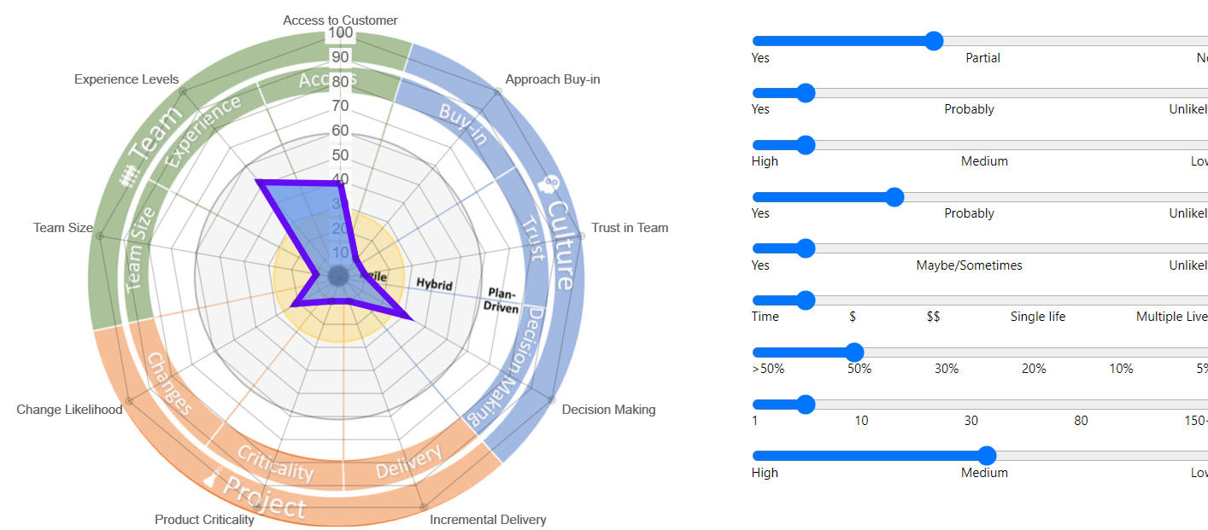
Project Life Cycle – Hybrid
Image : https://suitabilityfilter.com/

Slide 11
Project Life Cycle : Hybrid
Initiating
Development
Release
Transitioning
Closing

Slide 12

High-Level Plan
Jan - Feb
Project Initiation
Platform Creation
Basic Release 1.1
Mar - Apr
Release 1.2
Release 1.3
SEO Strategy
May-June

Slide 13
Role and Responsibilities

Slide 14

Resource Breakdown Structure
Role | People | Work Focus
Project Management | John Doe (Project Manager) | Overall project coordination, scope management, timeline tracking
Design Team | Alice Johnson (Lead Designer), UI/UX Designer | Visual design, user experience, design approval
Development Team | Bob Brown (Lead Developer), Front-End Developer, Back-End Developer, Database Administrator | Website development, coding, database management
Content Team | Emma Davis (Content Specialist), Copywriter | Content creation, CMS integration, content migration

Slide 15
Role and Responsibility Overview (RACI)
Project Activity | Project Team | Sales Team | Client | Support Team
Project Planning | R/A | C | C | I
Project Execution | R/A | I | C | I
Requirement & Design Approval | R | C | A | I
User Acceptance Testing | R | A | R | I
Deployment, Data migration and Go Live | R | I | C | R/A

Slide 16
Communication , Quality and Change

Slide 17

Communication Planning
Communication Type | Purpose | Frequency | Participants | Format / Tool
Project Status Review | Review Project Progress and Address Issues | Monthly | Project Team , Client , Sales Team | Zoom
Iteration Planning | Plan the work for coming Iteration | Every Two Weeks | Project Team | Zoom

Slide 18

Quality Management
Quality Objectives : Ensure: Functionality, usability, performance, and design consistency.
Quality Standards : W3C standards, GDPR, ADA and SEO guidelines
Testing Strategy
  Unit Testing: Validate individual components.
  User Acceptance Testing (UAT): Confirm with client reps.
  Performance Testing: Check speed, responsiveness, and stability.
Quality Metrics
  Error Rate: Monitor defects.
  Page Load Time: Meet target load times.
  Accessibility: Adhere to WCAG standards.
Continuous Improvement
  Retrospectives: Reflect on each Iteration to enhance processes.

Slide 19

Change Control Plan
Agile & Flexible: Embrace continuous change with regular backlog refinement, focusing on delivering value incrementally.
Client Collaboration: Engage the client in frequent check-ins and collaborative decision-making on scope adjustments.
Continuous Feedback: Incorporate client feedback and conduct retrospectives to refine the process and ensure alignment.

Slide 20
Risks and Assumptions

Slide 21

Project Risks
Risk ID | Risk | Potential Impact | Response Strategy
101 | User Resistance to Website Change | Lower User adaption | Involve user early in the process
102 | Technical Challenges with CSM | Delay in Development | Engage Experience Developers
103 | Resource Availability | Project delays if key team members become unavailable | Develop a resource backup plan, cross-train team members
104

Slide 22

Project Assumptions
ID | Assumptions | Impact if False
201 | Access to Necessary Resources | Project delays, inability to meet deadlines
202 | Stakeholder Availability for Feedback and Approvals | Slower decision-making, delayed project timelines
203 | CMS Compatibility with Existing Infrastructure | Additional costs and time required for custom solutions

Slide 23
Action Plan

Slide 24

Action Plan
Action | Objective | Person | Target Date
Conduct Requirements Workshop | Create High Level Requirements with the help of User Persona and User Journey Map | Project Team | 15-08-XX
Architecture Discussion & Recommendation | Review and recommend the system architecture for the website redesign. | System Architect and Project Team | 20-08-XX
Set Up PMIS (Jira) for Project Management | Ensure Jira is configured and ready for task Management and collaboration. | Project Manager | 10-08-XX
Team Building & Team Charter | Organize a team-building activity to foster collaboration and align the team on project goals. | Project Team | 12-08-XX

Slide 25

Question and Answers
By iZenBridge

